Slide 1

Text Analysis Algorithm: Topic Modeling
Notes:
s1: Hi everyone.Thank you for joining my presentation. My name is Anh Le. I have been in US for 7 years so far.
My bachelor degree was in Finance and I have earned my Master in Analytics at UT Dallas.
Today I will walk you through a very popular application in text analytics- Topic Modeling( or LDA),
It is a Machine Learning Algorithm that use unstructured data like our company's reviews for text analysis.
Now, It is an academic project with dataset that is sponsored by another company so I changed information. So for privacy purpose, I would assume we re talking about Ansira.
In fact, I used some Ansira public data that any users can find on Glassdoor to support my main idea. However, the techniques will be the same.

Slide 2
TABLE OF CONTENTS
GOALS AND SUMMARY
Exploratory Analysis
Text Pre-Processing
Topic Modeling (LDA)
Q&A
Notes:
2: Here are touchpoints of our contents. So first, To navigate you through these information and understand the role of TP in analytics, this is my goal and summary.

Slide 3
GOALS
SUMMARY
The major tasks are to detect words/phrases, and extract these quality texts from any messy data.
Apply text analysis (Machine Learning) for meaningful patterns from reviews on Glassdoor.
The relevant benefits are main ideas without having to read large volume of information.
The outcome will be a dynamic visualization of popular words and topics.
Each section of the project will lay out the context for the next step (108 reviews) from 2011.
This project consists of three main parts: exploratory analysis, text preprocessing, and Latent Dirichlet Allocation-topic modeling.
Notes:
s3: My objectives are, 1st to extract quality texts from any messy data, 2nd to gain useful patterns by using ML,
& the final goal is to output only main ideas without having to read all the reviews.
s4: With Scope, there are 108 reviews in total and the dataset timeline is from 2011
My project have 3 steps.They are... All these steps works together to eventually plot a dynamic visual.

Slide 4



Phases in Data Analytics
Topic Modeling – What/Why did it happen?
Process comments, surveys, performance reviews, etc.
Diagnose/describe the problems.
Feed text patterns into prediction.
Predictive Modeling- What will happen?
Classification model is an example.
Assign a predefined label to each interested group.
Recommend the right targets for adjustment.
Prescriptive Action – How to make it happen?
Decision tree is a typical method.
Optimize a set of decisions to gain the best expected value.
Provide feedbacks to the diagnosing step.
Notes:
s9: bird eye view of why topic modeling is important.
There are actually three main phases of analytics that transform any raw data ingredients into patterns, and patterns into a action:
1st phase is descriptive (predictive, and prescriptive modeling). this is where Topic Modeling belongs to, and
where we ask what is happening with ppl that own these comments, behaviors/problem/trend ? Predictive model will forecast possible future values or assign label to groups
last but not least Prescriptive will pick the best cherry among all course actions we have.
Taking online shopping journey as an example about this type of analytics. For example, you don’ have enough tracking data about customers, we may resort to their feedbacks and comments about their experiences. Now, topic modeling will find out which problem/ sentiments are the most outstanding. These may be products, web expriences, or customer service where we set up predictive models to assign label to customer group that are likely to churn/ cancel the cart. Then for each customer segments, we have several marketing mix ,and decision tree model will prescribe the best action improve customer retention.

Slide 5

EXPLORATORY ANALYSIS
Featured Ratings from Reviewers:
Bars and trends.
Demographic Characteristics:
Job types, levels, regions.
Comments:
Deleting empty rows/ invalid values.
Notes:
Now as I set out in my project goal, we will find out how I implemented this text analysis.
10: Any book has first few chapters to lay out general knowledges before going speciafically into the core. this is why we have Exploratory analysis. Any ML project cannot miss this step because It gives us a clear context about our interested objects: sth like demographics, operation and experience data.

Slide 6

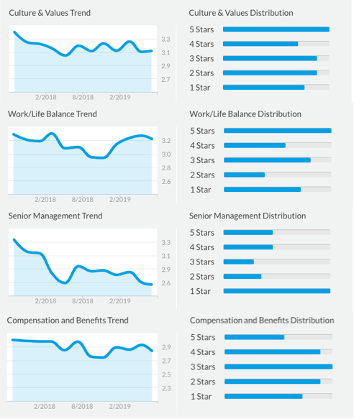
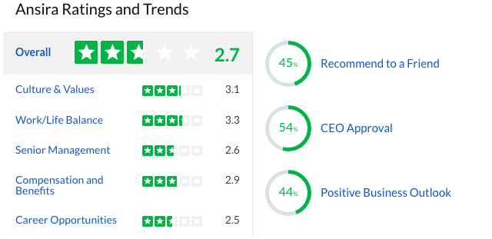
Notes:
s11: So this is my main dashboard of our company's ratings. If you are interested in more details over time, the trend chart and bars can be useful.
bar shows should simple distribution of all the seletion, and trend show company's latest performace.
If you hear of metrics that reflect company’s brand and growth, here are the metrics. Net promotor score to measure employee’s loyalty. CEO approval that measure part of company’s brand popularity, Business outlook is a sentiment metrics.

Slide 7
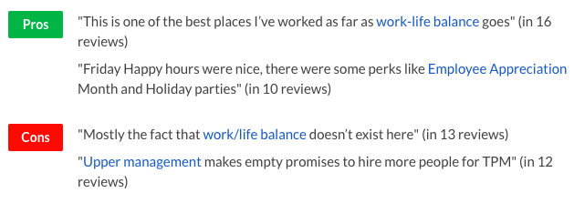
Demographic Data
Featured Ratings:
Business Outlook, Recommend to friend, CEO Approval, Overall Rating.
Demographic Characteristics:
States: Texas (31%), Missouri (29%), Illinois/ Oregon (4%)
Job: Sales (24%), Marketing/Business(8%)
Level: Full-time(99%), Current employee(56%)
Reviews are the focus of this project :
Pros.
Cons.
Advice to Sr.Management.
Notes:
How about demographics metric? Why
Any patterns/ problems detected, high chance will happen in TX, Sales, and fulltime current.
Bcs privacy purpose, I only use data that is on first review page of Glassdoor bcs its hard to acquire their API direcly. However, this is basic example of text analysis from Glassdoor. Find the terms that happens many time.
In fact, What im going to show you is more thorough analysis, but my caution is Any insights is not directly related to reviews about Ansira. It will only make sense in term techniques and intepretation method.

Slide 8

TEXT PREPROCESSING
Word Cleaning
Remove nonsense words, tokenize, and lemmatize.
Phrase Detection
Pros & Cons.
Text Transformation
Dictionary & Corpus.
Notes:
s12: My 2nd goal. Weird characters, wrong grammar, phrases. Human language how to translate into machine understanding. It takes 70-80%.
So deleting empties are just the first step of Text preprocessing. This is a really important part since It
take the largest amount of time in any data science project. now, I have summarized the whole pipeline into only three main tasks: ...

Slide 9

Word Cleaning
Raw text example
Remove new line characters
Remove punctuations & Tokenize the words.
Remove stop word ‘are’ .
Lemmatization:
Transforms word to its root.
Keep noun, adjective, verb, adverb.

Slide 10




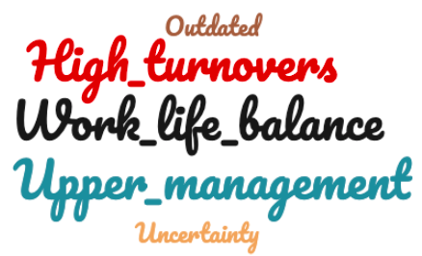
Phrases Detection
PROS
CONS
Notes:
s14: then Phrase detection. Since all words were tokenized, the ML could not detect without appropriate prepping.
Take Pros & Cons and my example, you we see some typical phrases here. The size phrase is more popular, yet the color
is just the color,just in case you wonder, does not have meaning. The purpose of detect phrase to cover the previous drawbacks.
After this step, all phrase and tokens will be turned into number series( call dictionary and corpus) because
ML will only understand binary vectors, which I am showing my final stage here.

Slide 11

TOPIC MODELING: Latent Dirichlet Allocation Algorithm
Performance metric
Number of topics & model quality
Dynamic visualization
Glossary
Findings
Interpretation
Recommendations
Usage Demo: Cons
Notes:
s15: In this section, I will demonstrate how I test my model quality and come up with some guide to use dynamic visuals.
This is probably the funniest part of the projects. So stay tuned.
How do you know how many topics are significantly OK?

Slide 12
Coherence Score
High coherence score means the words in each topics are more relevant to each other.
However, the trade-off of too many topics is difficulty in interpretation and visualization.
A rule of thumb is to test and try with number of topics manually until all the topic bubbles are evenly dispersed or not overlapped.
Notes:
s16: how many topics are enough?
I used a programming language called Python to code up this plot, where you see two main axis are number of topics and coherence score.
coherence score is a metric to measure how relevant terms are in each topics. Here the up trend means more number of topics chosen will
improve the relevance of terms per group. However, the tradeooff..., so I only stick to a max 20 topics so no chaos.

Slide 13
Notes:
s17,18: quick glance, to the left bubble chart of topics, and the right are the representative words.
From this point, the art of data science kicks in to support the technical side, where the rule of thumb is find nice& balanced dispersion.
I found 9 as the best number of topics for this visuals about Pros comments.

Slide 14
Dynamic Visuals: Glossary
Usage Recommendation
Intertopic Distance Map
Marginal Topic Distribution
Overall Term Frequency
Top Salient Terms
Lambda Metric (Λ)
Approaching salient terms to set up an overall context for further investigation of topics.
Drafting categories based on work themes or part-of-speech (noun, verbs, adjective).
Investigating topics that dominate at least 50%. Closer bubbles may share some meanings.
Adjusting relevance metric λ to balance popular terms with unique ones, and pick the least changed. A suggested metric is between 0.4-0.6
Refer some chosen words to the original reviews to better understand some syntax.
Keeping a context in mind before diving further. What type of reviews? Who wrote them?
Findings
Topics are unlabeled, so we need to find the words for labelling.
Do not care much about overlapping or tiny topics. They are noise.
This LDA algorithm will make more sense in more specified topics.
Notes:
To understand this dynamics, there are several special terms , recommendations, and tips of usage.
However, I did all the red-eyed labors for you at no charge, and my case studies earlier are my end results.
Now, The last thing I want to show is a short demo of this discovery.

Slide 15
Pros comments
Topics | Reviews
Topic 1 (19.7%) Benefit, life, pay, work, nice, balance, people | "This is one of the best places I’ve worked as far as work-life balance goes"
Topic 2 (19.5%) Appreciation, work, employee, flexible, day | "Friday Happy hours were nice, there were some perks like Employee Appreciation Month and Holiday parties"
Topic 3 (13.1%) Happy, hard, supplier, hour, lot | "Many large company activities/ events with weekly happy hours in the office"
Topic 4 (11.4%) Environment, great, group, client | "Continued focus on working with our great clients"
Notes:
s6: For Pros, there re four topics that represent more than 50% of all the terms that makes sense. By number, I mean
this topic owns the largest share of terms, the same for 2nd and so on.
So again, topic 1 has these words that one can guess a majority of reviews talk about salary/benefit. Here s an example.
topic 2 is,topic 3 ,topic 4 is, and corresponding example. Salient terms is a technical point that I will reveal later,
but basically it is just a list of the most influetial words.

Slide 16
Cons comments
Topics | Reviews
Topic 1 (90%): Work, life, pay, company, balance, employee,, year. | "Mostly the fact that work/life balance doesn’t exist here"
Topic 2 (10%) : Much,, stop, heavy, management,, upper. | "Upper management makes empty promises to hire more people for TPM"
Notes:
s7: reviews are negative or problems. As an example, topic 1 shows a great issues in sales that involve ... here is the proof.
topic 2 and 3 in total only 10%, so though say sth about truck drivers, I dont think it is urgent enough for any policy change.

Slide 17
Advice to Management
Topics | Reviews
Topic 1 (19.6%) Everyone, commission, team, accounts,opportunities | “Please continue the regular updates from our new CEO and Leadership Team on new happenings at Ansira. We want to know more about new accounts we are winning and new opportunities for me and my team to advance in.”
Topic 2 (13.6%) Communicate, employees, levels, positive, product | “Keep communicating with employees at all levels. Employees see positive changes happening. They are excited and eager to be a part of it. Find ways to keep them engaged and productive.”
Topic 3 (12%) Invest, skills, time | “ Invest in your people. Actually allocate time for your employees to work on their bettering their skills.”
Topic 4 (11%) Field, Ansira, everyone, treat | “This is pointless field for this company. They’re all knowing at Ansira and everyone they hire is treated like a half-wit. “
Notes:
s8: How about we need a solution to all these problems, we may ask for some advice. This case study has a better approach if you
look at these three bullets first, where I classify the salient terms. These are the navigators for my word list. Crosscheck
with some reviews to get a sense of context or syntax.
I found sentiments, not bad, it just people advise you to avoid doing things.
Once again, you see truck driver, smaller problem, but if you care, this salient terms can be an action.

Slide 18
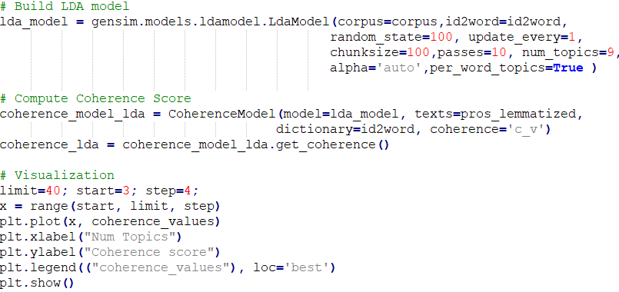

Appendix
Notes:
Visuals with Advice:
I mention to explain the salient terms right?
Now this top 30 terms has two way of sorting, either by high frequency, or by its uniqueness. "work" is popular in many topics ,but wine only 7 as exclusive.
A list combining both of these features have the salient terms. It give you a general context of what is going on here.
From there you may want to dive into each topic. #1 has most number of tokens, then 2,3, and so on.
Now, in my case study, I label this topic as salary & benefit by collecting these terms.
As you see, longer red bars mean a popular term in topic 1, compared to blue bars. Word benefit pops up 75 times in topic 1 vs 100times in all reviews.
however, these words also exist in other topic, so how you tell the difference among topics. This is where lambda, a relevance metric kicks in.
lambda has range from 0 to 1. Currently, the frequency feature holds for lambda 1, but if adjusting to zero, these are unique words like perk.
However, since these terms not popular, we may want a balance where lambda between.4 to .6. As a result, I have the best of both features.
One last thing is although you see some connection among these words, it always better to cross check with some reviews.
Again, this is where the art of data science kicks in
So if you go to raw reviews, and Crtl-F, you may want to see them in context, and make sure understand their syntax,
cuz may be you want to understand part of speech like verb or adjective( not just nouns).
So to sum up, if you now want to know only main ideas of all the Pros reviews, you just need 5-10 mins.
Thank you for watching my demo. I you have any questions, It s time to let me know.

Slide 19
Q&A

